Slide 1
SHORTEST PATH IN POLYGONAL OBSTACLES ENVIRONMENT
LE PHAM TUYEN
Artificial Intelligence Lab
Department of Computer Engineering
Kyung Hee Univerity

Slide 2

Example Polygon
Vertices
Outer polygon:
(0, 0),
(0, 5),
(5, 5),
(5, 0),
(4, 1).
Holes
(1, 3),
(1, 4),
(2, 4),
(3, 2),
(2, 3)
Question: Find shortest path from start to end
Start (1, 1)
End (4, 4)
End
Start

Slide 3
Step-by-step
Step 1: Triangulate polygon using triangulate function (library)
Step 2: Represent graph of triangles
Step 3: Find index of triangles which start and end point is inside them
Step 4: Find shortest channel using Dijkstra algorithm (library)
Step 5: Find shortest path by loop through shortest channel.

Slide 4
Step 1: Triangulate polygon using triangulate function (library)
Triangulate function:
“pDzen”: parameters
p: Triangulates a Planar Straight Line Graph : mandatory
D: Conforming Delaunay: optional
z: Numbers all items starting from zero (rather than one): mandatory
e: Generates an edge list: mandatory
n: Generates a list of triangle neighbors: mandatory

Slide 5
Step 1: Triangulate polygon using triangulate function (library)
Triangulate function:
&in: contains:
pointlist: vector of vertices of polygon
[x0, y0, x1, y1, x2, y2,…]
[0, 0, 0,5,5,5,5,0,4,1,…]
segmentlist: vector of edges of polygon
[0, 1, 1, 2, 2, 3, 3, 4, 4, 0, …]
holelist: vector of points inside holes
[x0, y0, x1, y1,…]
[1.5, 3.5]

Slide 6
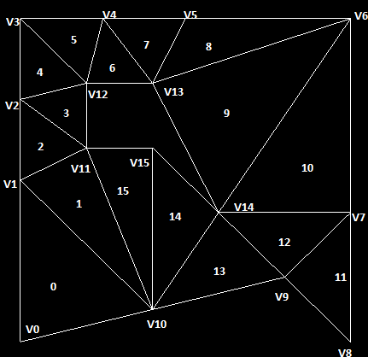
Step 1: Triangulate polygon using triangulate function (library)
Triangulate function:
&out: contains
pointlist
[V0_{X},V0_{Y}, V1_{X},V1_{Y}, V2_{X},V2_{Y},…]
Segmentlist
[0,1, 1,2, 2,3,…]
trianglelist
[0,1,10, …]
Neighborlist
[-1,-1,1,…]

Slide 7
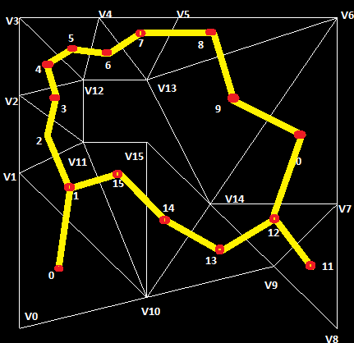
Step 2: Represent graph of triangles
Node:
Center of triangle
Distance between 2 nodes:
Distance between center of 2 triangle

Slide 8
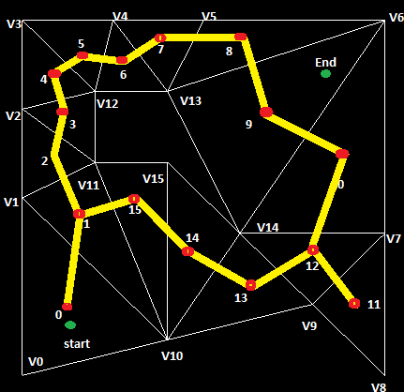
Step 3: Find index of triangles which start and end point
Index of start point is:
0
Index of end point is:
9

Slide 9
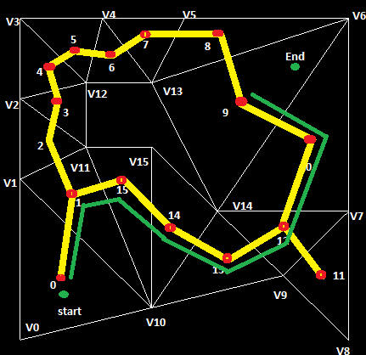
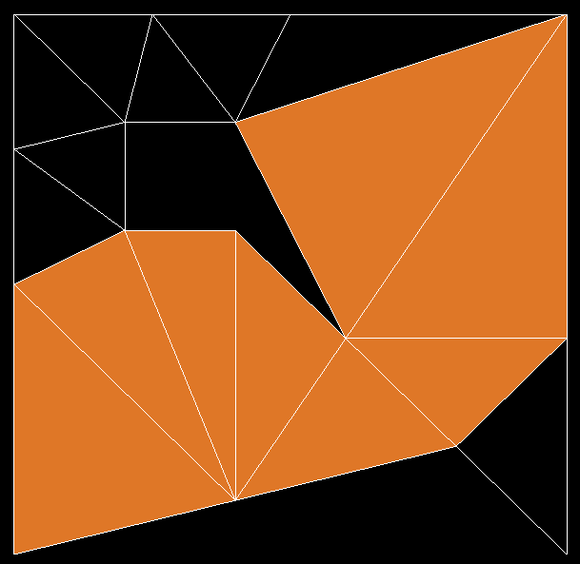
Step 4: Find shortest channel using Dijkstra algorithm

Slide 10
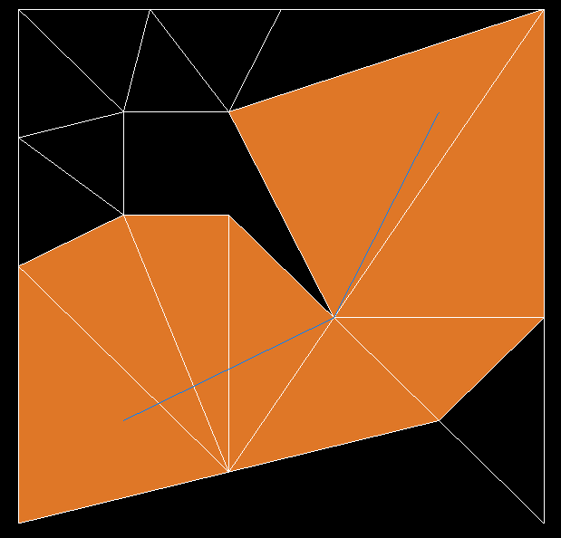
Step 5: Find shortest path using Funnel algorithm

